Slide 1
ImagiNarrate
Building a Narrative with Images and Generated Captions
Team:Group 46
Asmita Chotani, Apurva Gupta, Chetan Chaku, Priya Nayak, Rutuja Oza

Slide 2
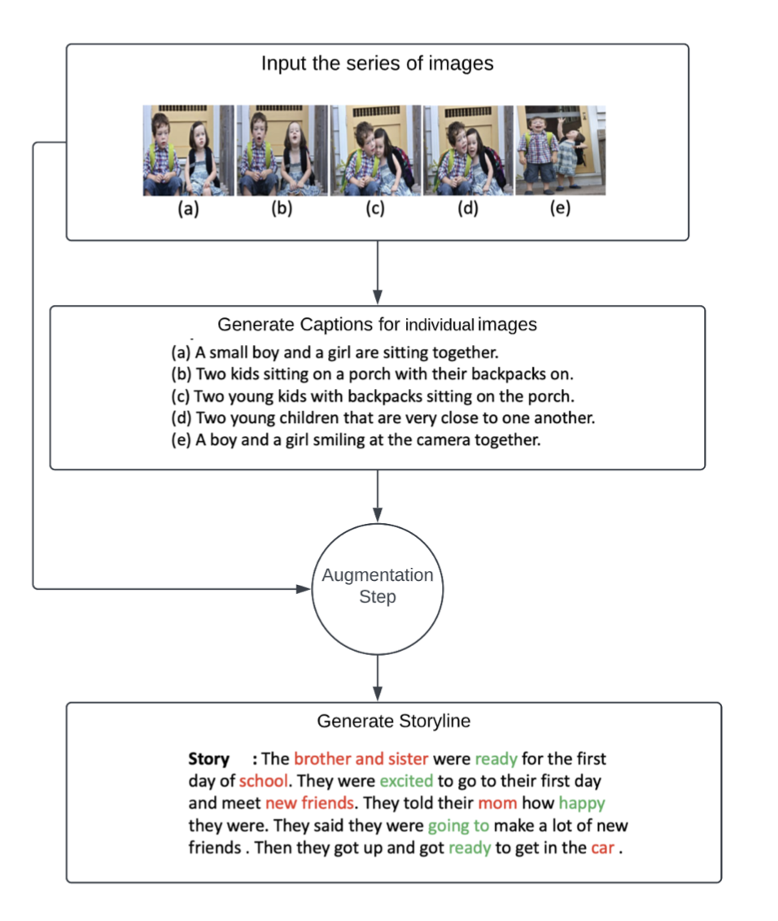
Motivation
Growing interest in visual captioning and limited ability of machine to understand complex human-like scenarios.
Baseline: AREL model - generates story based on sequence of images.
Proposed model: Generates caption and augments with image sequence to produce story.
Future scope: Creating novels from comic books for the visually impaired audience.
Notes:
AREL model -> baseline
What new are we adding to the model?
The proposed model uses AREL model (generating story based on a sequence of images) as a baseline.
Our model builds onto the AREL model by augmenting the sequence of images with generated captions & generating stories based on those.
Notes:
Future scope: Unlike AREL model, our model will consider dialogues from the comics.

Slide 3
Problem Definition
Input: Sequence of 5 ResNet-152 features
Output: A story related to the sequence
Training:
Generation of caption per image
Augmentation of ResNet-152 embeddings with caption embeddings
Generation of story
Incorporating captions along with images provides informative descriptions for the model to understand & build cohesive stories.
Notes:
I/p o/p of the proposed model
How are we using the captions
The proposed model takes in a sequence of resnet features associated with images and generates a story.
Internally, the sequence of resnet features are used to generate one caption per image of the sequence using LSTM based caption generation model.
Each resnet feature is augmented with generate caption embeddings and fed to the story generation model.

Slide 4
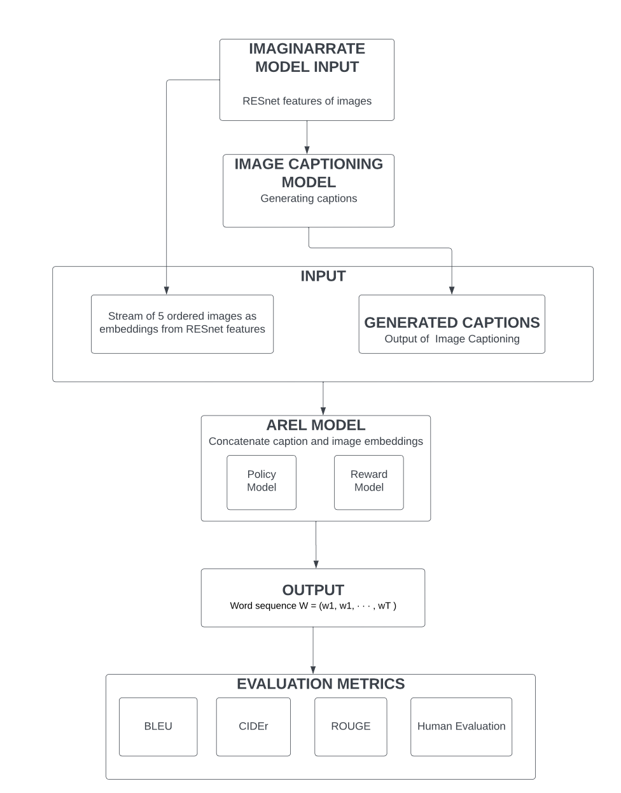
Proposed Solution
Caption generation model: LSTM based encoder - decoder structure
Story generation model: RL framework. Encoder uses GRUs & decoder uses GRU-RNNs.
Dataset:
ResNet-152 features of VIST images
Ground truth stories from VIST dataset
Hyperparameters:
Vocab size: 9839 words.
Epochs: 60 - computational constraints
210819 unique images
Notes:
Details of the models used
Details of data
Caption generation - LSTM based encoder decoder model
Story generation - Reinforcement Learning framework with Generative & Discriminative models working together. Both these models use GRU for encoding & GRU-RNN for decoding.
Trained the model for 50 epochs - computational constraints.
Dataset: ResNet-152 features of dataset VIST images, ground truth stories from VIST dataset
210819 unique images used for training & testing.
Vocab generated from ground truth stories (human annotated) of VIST dataset containing 9839 words
The LSTM based caption generation model takes in a sequence of images, and outputs a caption associated with each of these images.
These caption embeddings are then augmented with the corresponding image embedding and input to the story generation model.
The story generation model utilizes a reinforcement learning framework (generative model & discriminative model)

Slide 5
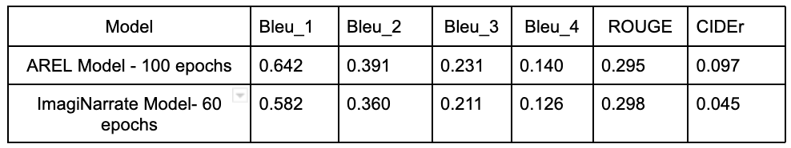
Result
Natural Language Generation Metrics for Evaluation:
BLEU, CIDEr, ROUGE for generation fluency.
Increasing training epochs could improve generation fluency.
Notes:
Mention triple <video,description,aspect> when talking
Notes:
Should we include Meteor score here? Due to version issues & time constraints, could not be incorporated.

Slide 6
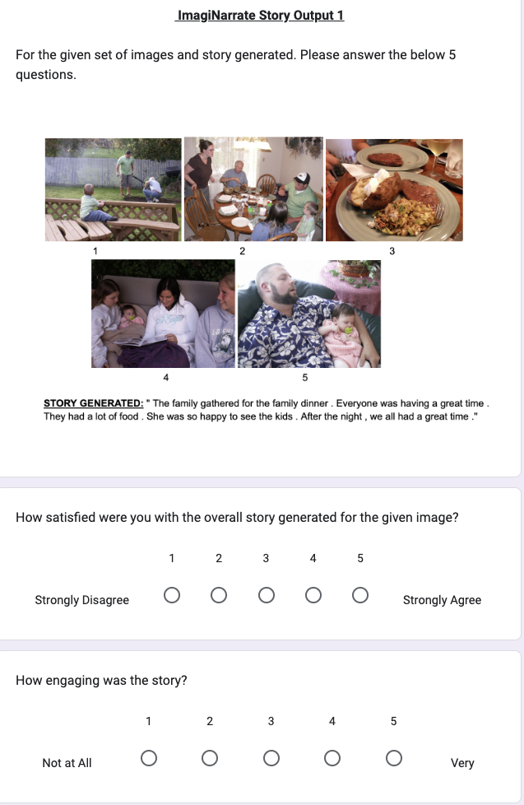
Result
Human Evaluation:
Human feedback via circulated Google Form.
Questions Asked:
How satisfied were you with the overall story generated for the given image?
How engaging was the story?
How easy was it to understand the story?
How well did the story flow and maintain a coherent narrative?
How well did the story integrate with the given image?
Google Form Link: https://forms.gle/1LDEwmbgRAC1V17Y7
Notes:
Notes:
Todo: average for each of the questions

